Slide 1


SpeakRite
English Improvement Coach for Indian Accented Tones
Enhancing Communication Skills for Indian Speakers
SpeakRite

Slide 2


Index
Project Outline
The Team
What are we trying to build?
Abstract
Business Use Cases
Important Use Case
Concepts Used
Workflow at a Glance
Data Collection Process
Exploratory Data Analysis
Implementation of CRISP-DM Methodology
Models Used
Model Comparison
Challenges Faced
Code Snippets
Our Learnings
Key Takeaways
Future Scope
SpeakRite

Slide 3


Project Outline
Problem Statement
The problem statement revolves around creating an English Improvement Coach tailored for Indian accented tones. The goal is to leverage speech to text and text to speech models, along with a chat interface, to facilitate English language coaching specifically designed for individuals with diverse and native accents.
Aim
The aim is to develop an English Improvement Coach tailored for Indian accented tones by effectively utilizing speech to text and text to speech models along with a chat based interface.
SpeakRite

Slide 4


The Team
MEET THE TEAM!!
SpeakRite

Slide 5


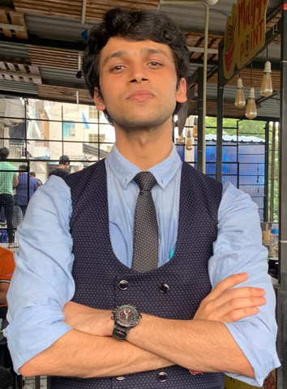



Group 5
The Team - AIChemists
Anika
Kamath
Kapilesh Neelakandan
Bhavishya
Sharma
Data Preprocessing, Analysis, Model Development and Documentation
Openai-GPT API Integration, gtts Integration, Capturing Speech Input and Front-End Development using gradio
Systems Modelling,
Dataset Research,
Grammar correction
Models Implementation,
Documentation
Santhosh Kumar Santhanam
Aryan
Gupta
Adithya
Murali
Data Preprocessing, Analysis, Model Development, Comparing Optimal Model and Documentation
Openai-GPT API Integration, gtts Integration, Capturing Speech Input and Front-End Development using gradio
SpeakRite

Slide 6


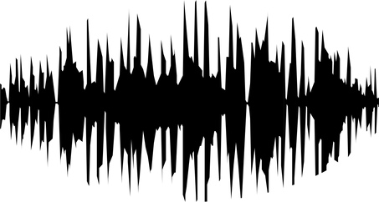
What are we trying to build?
Audio Data
gTTS
Custom ASR + OpenAI Whisper
GPT-3.5
speech-to-text
Accented English: Svarah
Transcription
Corrected Text
Refined English Audio
SpeakRite

Slide 7

Abstract
Acquiring Accented Indian English Audio Dataset
Svarah: Comprises diverse Indian accents in .wav file format, as a foundational resource for training and validating the speech to text and text to speech models.
Customizing and experimenting with various speech to text models such as OpenAI Whisper, Wav2Vec2 and HuBERT
For transcription and analysis of Indian accented speech, addressing the nuances of different regional accents.
Building to Speech to Speech chat interface using Gradio
Provides feedback, and language improvement, addressing the specific needs and nuances of Indian speakers.
SpeakRite

Slide 8

Business Use Cases
1 Language Training Institutes: Implementing the English Improvement Coach in language training institutes to offer specialized English language coaching for individuals with Indian accents
2 Corporate Training Programs: Integrating the system into corporate training programs, especially in organizations with a significant number of employees from India or individuals with Indian accents.
3 English Language Coaching Services: Incorporating the system into existing English language coaching services, particularly those providing personalized coaching to individuals with specific language requirements, including Indian accent considerations
4 In Customer Support Services: International companies in the technology, finance, and e-commerce sectors, outsource their customer service operations to call centers in India, tools like these can help in briding the communication gap caused due to accented intonation.
SpeakRite

Slide 9

Important Use Case
Enhancing Public Speaking Skills with
Integrated 3D Models and Text-to-Speech Technology
Innovative Integration: Combining Text-to-Speech technology with 3D models creates a platform to refine public speaking skills through text correction and facial expression simulation.
Real-time Guidance: Analysis of final audio enables 3D models to provide visual feedback, aiding users in refining speech delivery instantly.
User-Centric Environment: This integrated solution offers pronunciation assistance and visual guidance, fostering confidence in public speaking scenarios. This system elevates traditional training, enhancing user performance in public speaking with comprehensive feedback.
SpeakRite

Slide 10
Concepts Used
Data Analysis and Visualization
Training a Custom ASR using Transformers and OpenAI Whisper
Integration of OpenAI APIs for text improvement
Gradio - For building User Interface
Incorporating Google Text to Speech Engine for Audio Outputs in different accents.
Fine-tuning of Regional Data (Filtering Regions as per Accent)
GitHub - Version Control and Development
Pandas Profiling - EDA
SpeakRite

Slide 11
Workflow at a Glance
Data Acquisition and Preprocessing
Model Training and Experimentation
Converting the speech to text for improvement
Providing a text to speech output of improved speech
Building the Front-end using Gradio
Carrying out research and acquiring datasets consisting of a wide range of Indian Accents
Performing EDA and carrying out filtering of demographic data as per accent type.
Using selected regional data (TN) to train a custom ASR
Fine-tuned the audio parameters to build a Custom ASR on various models such as Wav2Vec, HuBERT and OpenAI Whisper.
As per the model and integration constraints, we chose to proceed with the OpenAI Whisper (base) model.
Converting the transcribed data to text input for the GPT-3 API to process and handle requests via a python script.
This script takes in gramatically incorrect text input and processes it to generate corrected and improved text output.
Using Google’s text to speech engine, the improvised text is converted to an audio as well, which is available in different global accents.
Using Python’s in-built module, Gradio, to build a component - based user interface to host locally and deploy on a public domain using version control tools like GitHub.
SpeakRite

Slide 12

Data Collection Process
Common Voices by Mozilla - WorldWide Accent Dataset
Svarah - An Indic accented English speech dataset
Svarah - An Indic accented English speech dataset
Dataset which suits our purpose the most
AccentDB by Tensorflow
SpeakRite

Slide 13
Exploratory Data Analysis
MEET THE TEAM!!
SpeakRite

Slide 14
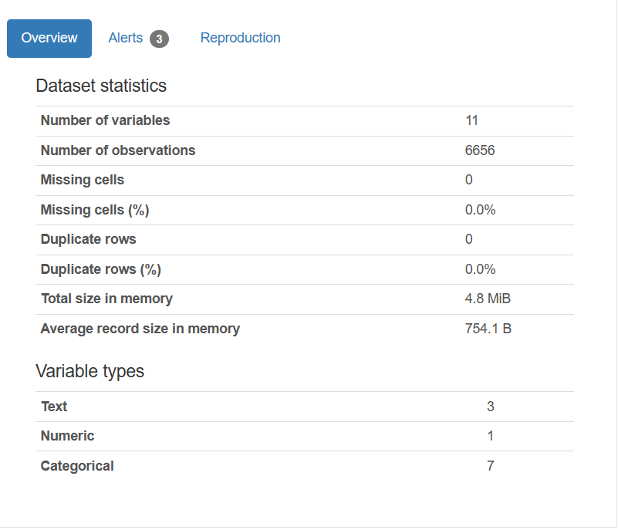
Exploratory Data Analysis - Svarah
SpeakRite

Slide 15
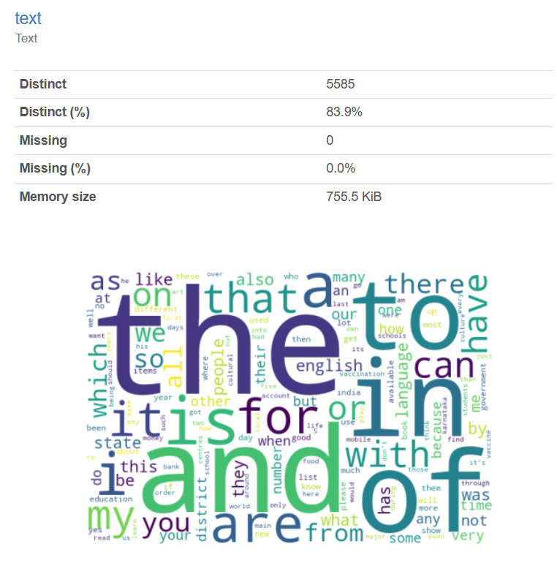
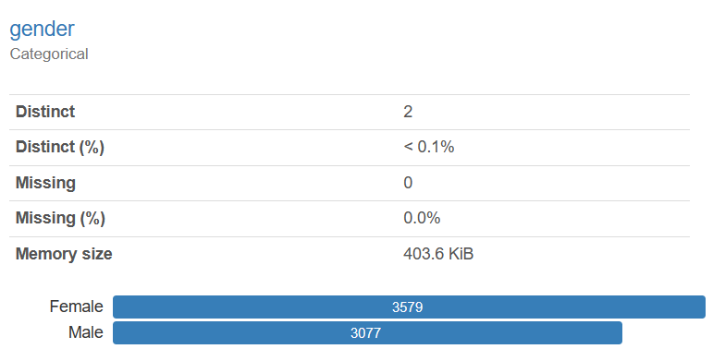
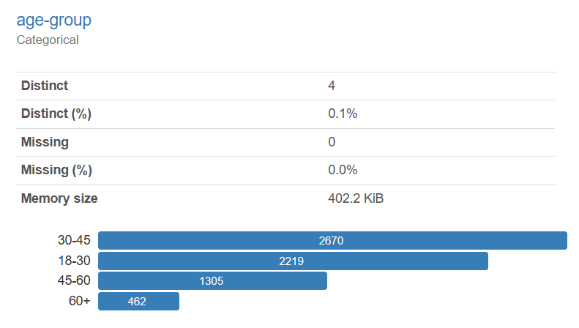
Exploratory Data Analysis - Svarah
SpeakRite

Slide 16
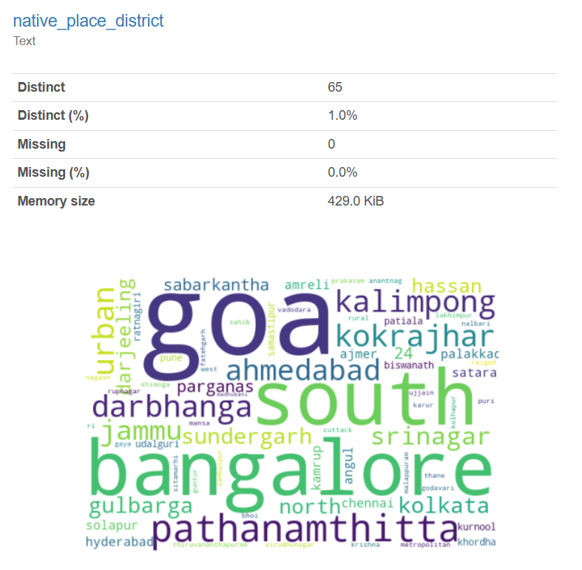
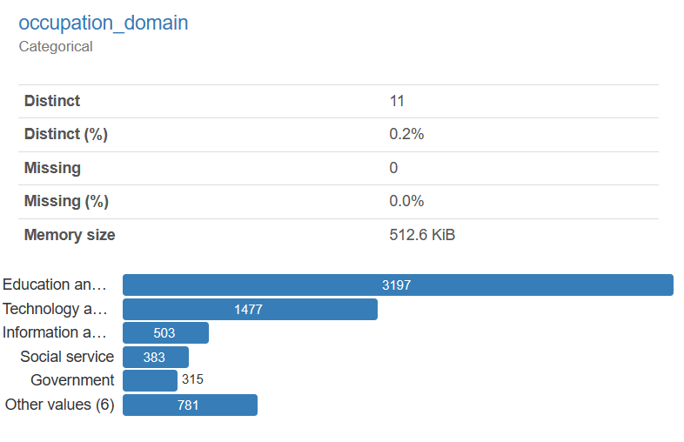
Exploratory Data Analysis - Svarah
SpeakRite

Slide 17
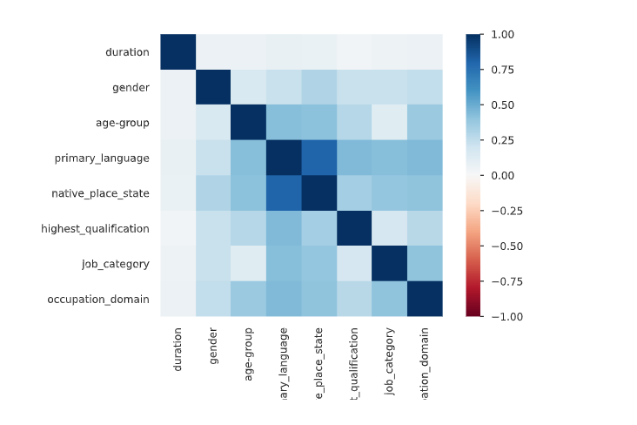
Exploratory Data Analysis - Svarah
SpeakRite

Slide 18
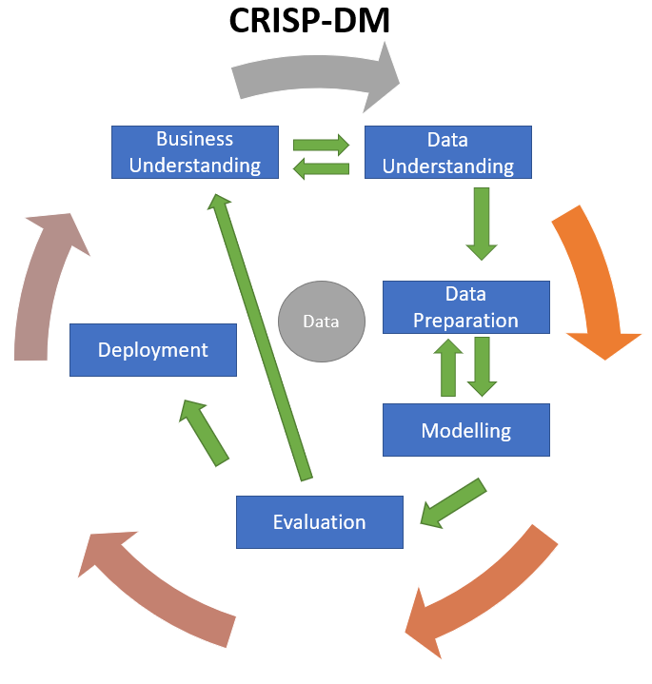
Implementation of CRISP - DM Methodology

Slide 19




Algorithms (Models) Used
OpenAI Whisper
GPT3 Transformer
Google Text-to-Speech
Input audio to Text
Text Optimization / Grammar correction
Optimized text to Speech conversion
SpeakRite

Slide 20
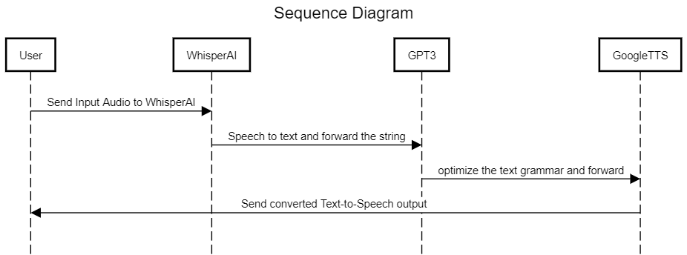
Sequence Diagram
SpeakRite

Slide 21
Problems Faced in Training Previous Models
Wav2Vec
HuBERT
LLaMa
Computational resources: Training Wav2Vec models can be computationally expensive, requiring powerful hardware and significant training time.
Clustering Quality: HuBERT relies on k-means clustering to generate pseudo-labels for pre-training. Poor clustering quality can lead to inaccurate labels and hinder model performance, especially when dealing with accented datasets.
Formatting and Preprocessing: LLaMA has specific input format requirements. Properly format and preprocess your custom data to ensure compatibility with the model's architecture, which was challenging to integrate with the speech to text model
speech to text
text to speech
SpeakRite

Slide 22

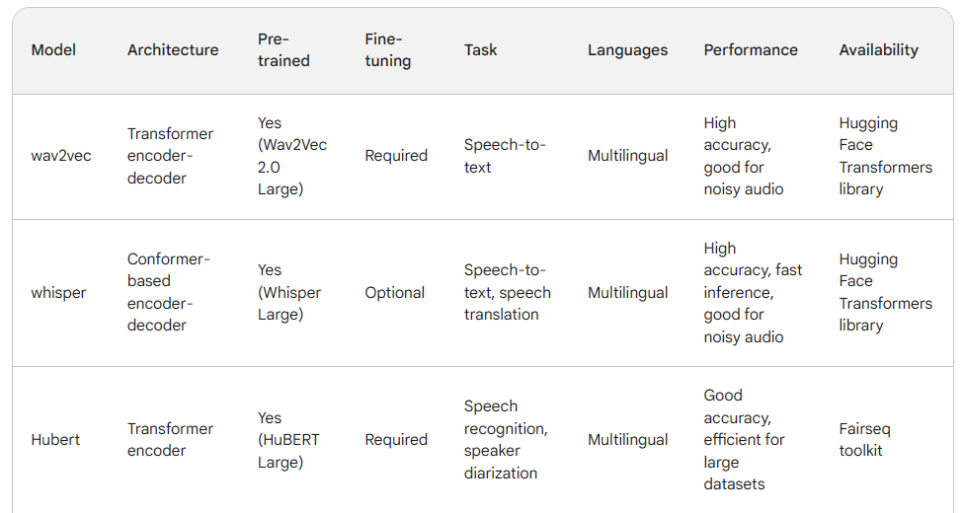
Model Comparison
SpeakRite

Slide 23
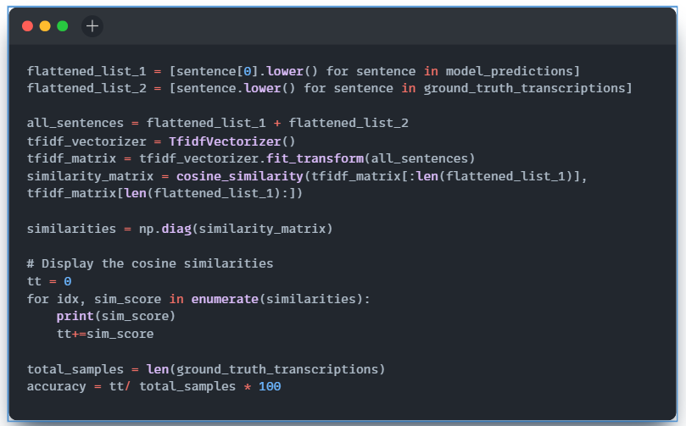
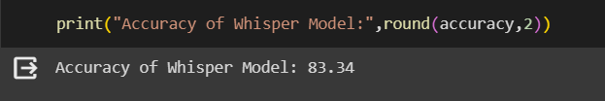
Model Comparison (Metric : Accuracy)
Wav2Vec
Whisper
HuBERT
62 %
83.34 %
67.62 %
SpeakRite

Slide 24

Models Used
OpenAI Whisper
Whisper is a Transformer based encoder-decoder model, also referred to as a sequence-to-sequence model.
We have trained WhisperProcessor with our dataset to :
Pre-process the audio inputs (converting them to log-Mel spectrograms for the model)
Post-process the model outputs (converting them from tokens to text)
SpeakRite

Slide 25

Models Used
GPT - 3
GPT-3, or Generative Pre-trained Transformer 3, is a state-of-the-art language processing artificial intelligence model developed by OpenAI.
GPT 3 HAS BEEN TRAINED FOR-
Natural Language Understanding:
Example: GPT-3 is trained to understand
and generate human-like text, enabling it to
perform tasks such as language translation,
summarization, and question-answering.
SpeakRite

Slide 26
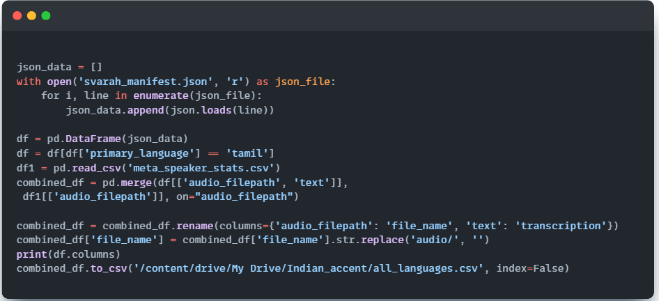
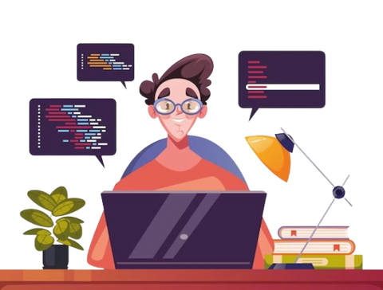
Code Snippet: Pre-Processing
SpeakRite

Slide 27
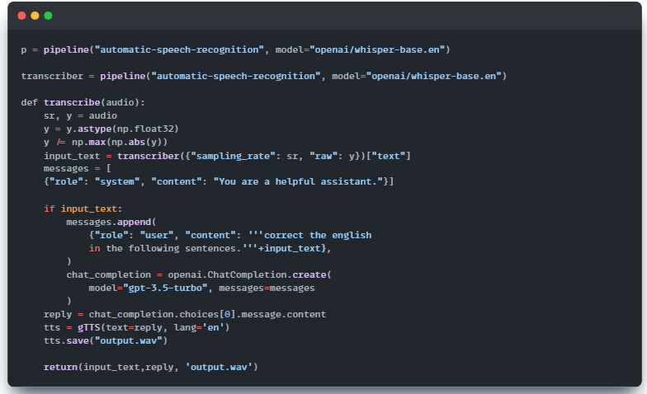
Code Snippet : Model Integration
Integrating the Custom ASR and the GPT-3 using Gradio Interface
SpeakRite

Slide 28
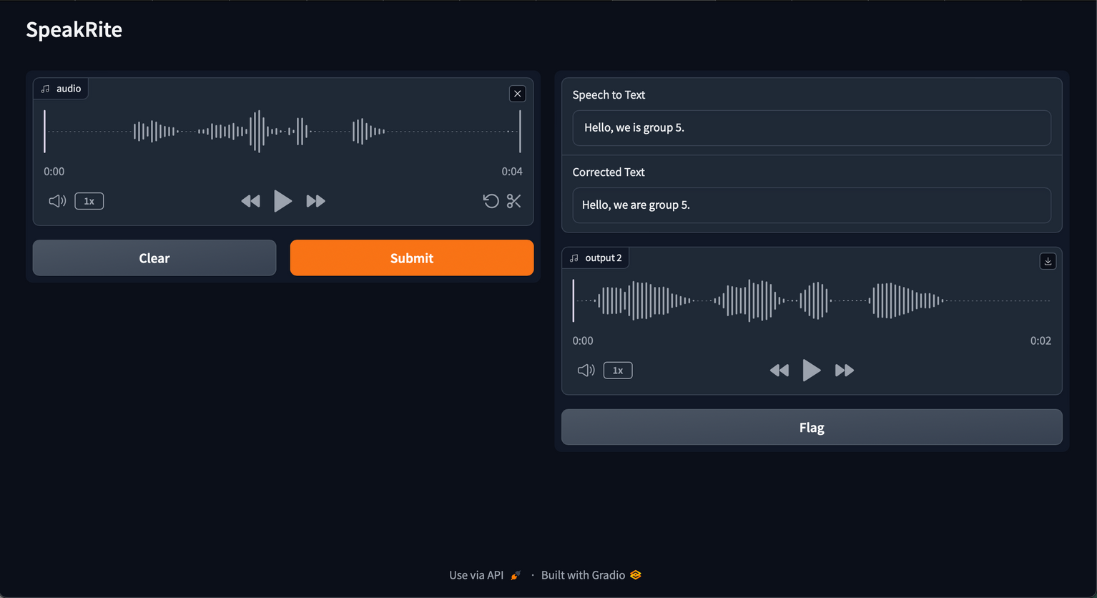

User Interface
SpeakRite

Slide 29

Our Learnings
Structure of a Project
Neural Networks
Problem Research
Identifying Problem Statement
We learnt about the proper and formal way of presenting a Project and how the breakdown of tasks is to be carried out.
Learning about diverse, pre-existing Speech and Text synthesis models , comparing them and integrating them with our project.
Dive into modules designed
to address specific pronunciation challenges associated with Indian accents.
Practice words and phrases commonly mispronounced, and receive personalized feedback.
Identify and overcome common grammatical challenges faced by English learners with Indian accents.
Engage in interactive lessons that focus on improving grammar skills in real-world scenarios.
SpeakRite

Slide 30

Challenges Faced
Diverse Accent Variations:
Indian English encompasses a wide range of accents and dialects, which can pose a challenge when developing speech-to-text and text-to-speech models.
Model Training and Adaptation:
Training speech-to-text and text-to-speech models to effectively recognize and generate Indian accented English requires specialized adaptation and fine-tuning
Data Quality and Availability:
Ensuring the availability of high-quality, diverse Indian accented speech data for training the models can be a significant challenge.
Overcoming Noise
and Disturbances:
The GitHub dataset may have variability in quality and background noise, which can impact model training.
SpeakRite

Slide 31
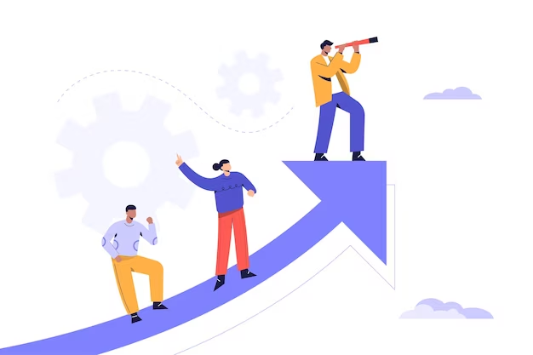
Future Scope
Expansion to Other Regional Accents:
Extending the English Improvement Coach's adaptability to encompass a broader range of regional accents within India, addressing the diverse linguistic landscape and catering to the varied needs of English language learners across the country.
Augmenting Public Speaking with Real-time Feedback and 3D-TTS Synergy:
This innovative synergy blends real-time speech analysis for Indian accented English with integrated 3D models and Text-to-Speech technology. It offers instant pronunciation corrections, tailored language tips, and facial expression simulation. Empowering users in refining their speech, it's a transformative approach revolutionizing public speaking training.
Gamification and Engagement:
Incorporating gamified elements, progress tracking, and rewards systems to maintain user motivation and engagement in the language learning process, tapping into cultural preferences and learning styles prevalent in India.
Personalized Learning Paths:
Developing adaptive learning algorithms that tailor course content and exercises to the individual user's proficiency level, learning pace, and specific areas of improvement, taking into account the nuances of Indian English accents.
SpeakRite

Slide 32

Key Take-aways
1
2
3
4
The Importance of Tailored and Inclusive Solutions in Language Technology Advancements
The Value of Culturally Relevant Approaches in Enhancing Language Learning
The Importance of Adapting Technology to Meet Diverse Linguistic Needs
Challenges in Creating Specialized Models for Regional Accents
SpeakRite

Slide 33

Team AIChemists
SpeakRite

